Slide 1
BITS Pilani presentation
Mridul Moitra
Cloud Computing

Slide 2
<CSI ZG527 / SS ZG527 / SE ZG527
Cloud Computing
Lecture No. 3

Slide 3
IaaS
Notes:
RL 3.1

Slide 4


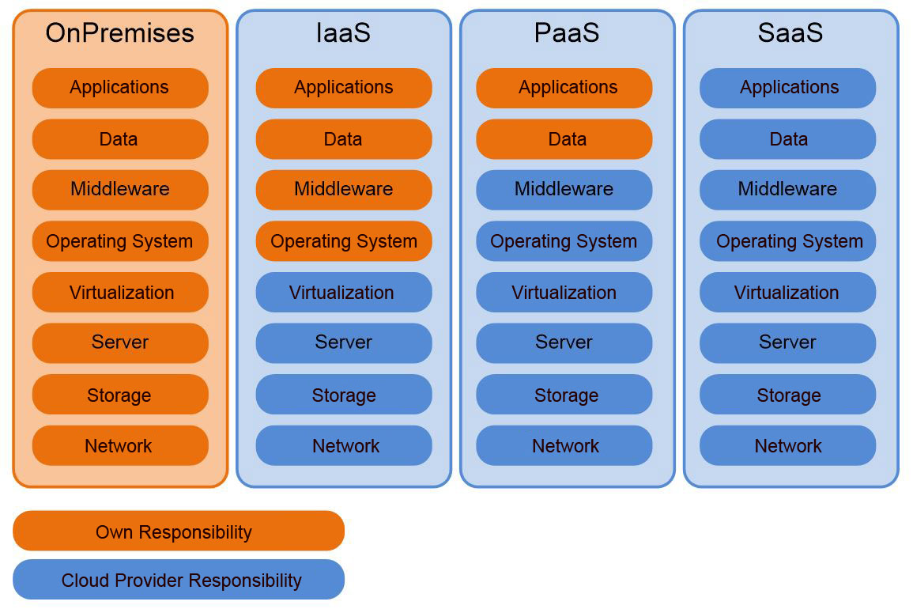
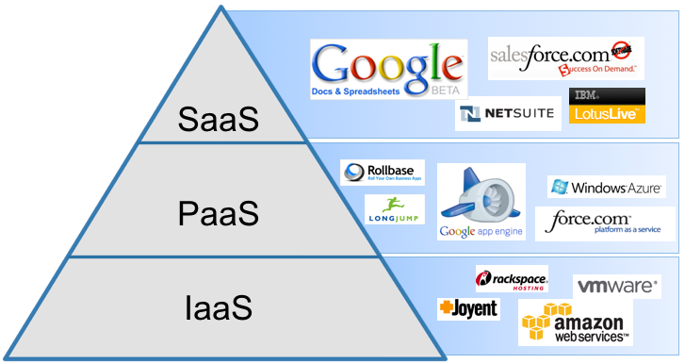
heard of 3 models of Cloud Computing?
Yes, Yes, IaaS, PaaS and SaaS

Slide 5
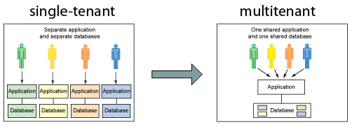
Key concepts of IaaS
Cloudbursting: The process of off-loading tasks to the cloud during times when the most compute resources are needed
Multi-tenant computing
Resource pooling: Pooling is a resource management term that refers to the grouping together of resources (compute(cpu), network(bandwidth), storage) for the purposes of maximizing advantage and/or minimizing risk to the users
Hypervisor

Slide 6
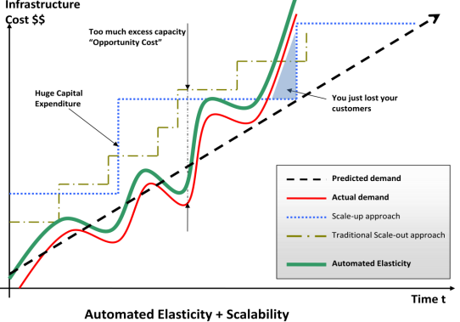
Two primary facets that make IaaS special
Elasticity:
Wikipedia: “In cloud computing, elasticity is defined as the degree to which a system (or a particular cloud layer) autonomously adapts its capacity to workload over time”
OR simply put “Ability of a system to expand or contract its dedicated resources to meet the demand”
&
Virtualization

Slide 7
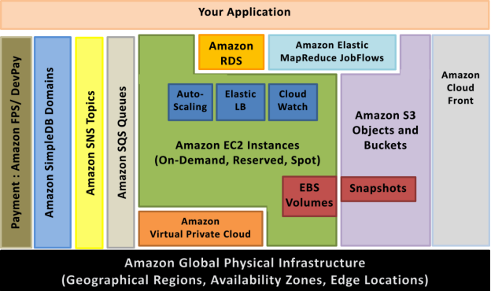
AWS infrastructure services

Slide 8
Amazon Elastic Compute Cloud (Amazon EC2)
Web service that provides resizable compute capacity in the cloud
Can be bundled with OS, application software and associated configuration settings into an Amazon Machine Image (AMI).
Use these AMIs to provision multiple virtualized instances
Decommission them using simple web service calls to scale capacity up and down quickly, as capacity requirement changes.
On-Demand Instances - pay for the instances by the hour
Reserved Instances - pay a low, one-time payment and receive a lower usage rate to run the instance
Spot Instances - bid for unused capacity and further reduce your cost.
Instances can be launched in one or more geographical regions.
Each region has multiple Availability Zones. Availability Zones are distinct locations that are engineered to be insulated from failures in other Availability Zones

Slide 9
EC2 Elastic Properties
Elastic – Amazon EC2 enables you to increase or decrease capacity within minutes, not hours or days.
You can commission one, hundreds or even thousands of server instances simultaneously.
controlled with web service APIs, application can automatically scale itself up and down depending on its needs.
Elastic Block Store vs. local Disk (not backup)
Elastic IP Addresses vs. Static IP Addresses
Interesting charging scheme; you are charged when not using it
programmatically remapping your public IP addresses to any instance in your account

Slide 10
EC2 Instance Type
Instance Type | Instance Name | Application Suitability
General Purpose | T2,M3, M4 | Development environments, build servers, code repositories, low-traffic websites and web applications, micro services, early product experiments, small databases
Compute Optimized | C3, C4 | High performance front-end fleets, web-servers, batch processing, distributed analytics, high performance science and engineering applications, ad serving, MMO gaming, and video-encoding
Memory Optimized | R3 | We recommend memory-optimized instances for high performance databases, distributed memory caches, in-memory analytics, genome assembly and analysis, larger deployments of SAP, Microsoft SharePoint, and other enterprise applications.
GPU | G2 | 3D application streaming, machine learning, video encoding, and other server-side graphics or GPU compute workload
Storage Optimized | I2 | NOSQL Databases like Cassandra and MongoDB, scale out transactional databases, data warehousing, Hadoop, and cluster file systems.
Dense Storage | D2 | Massively Parallel Processing (MPP) data warehousing, MapReduce and Hadoop distributed computing, distributed file systems, network file systems, log or data-processing applications
Notes:
Amazon EC2 provides a wide selection of instance types optimized to fit different use cases. Instance types comprise varying combinations of CPU, memory, storage, and networking capacity and give you the flexibility to choose the appropriate mix of resources for your applications. Each instance type includes one or more instance sizes, allowing you to scale your resources to the requirements of your target workload.
General Purpose
T2
T2 instances are Burstable Performance Instancesthat provide a baseline level of CPU performance with the ability to burst above the baseline. The baseline performance and ability to burst are governed by CPU Credits. Each T2 instance receives CPU Credits continuously at a set rate depending on the instance size. T2 instances accrue CPU Credits when they are idle, and use CPU credits when they are active. T2 instances are a good choice for workloads that don’t use the full CPU often or consistently, but occasionally need to burst (e.g. web servers, developer environments and small databases). For more information seeBurstable Performance Instances.
Features:
High Frequency Intel Xeon Processors with Turbo up to 3.3GHz
Burstable CPU, governed by CPU Credits, and consistent baseline performance
Lowest-cost general purpose instance type, and Free Tier eligible (t2.micro only)
Balance of compute, memory, and network resources
ModelvCPUCPU Credits / hour Mem (GiB) Storage t2.nano130.5EBS-Onlyt2.micro161EBS-Only t2.small1122EBS-Only t2.medium2244EBS-Only t2.large2368EBS-Only
Use Cases
Development environments, build servers, code repositories, low-traffic websites and web applications, micro services, early product experiments, small databases.
M4
M4 instances are the latest generation of General Purpose Instances. This family provides a balance of compute, memory, and network resources, and it is a good choice for many applications.
Features:
2.4 GHz Intel Xeon® E5-2676 v3 (Haswell) processors
EBS-optimized by default at no additional cost
Support for Enhanced Networking
Balance of compute, memory, and network resources
ModelvCPUMem (GiB)SSD Storage (GB)Dedicated EBS Throughput (Mbps)m4.large2 8EBS-only 450
m4.xlarge4 16EBS-only 750
m4.2xlarge8 32 EBS-only1,000
m4.4xlarge16 64 EBS-only2,000
m4.10xlarge 40 160 EBS-only4,000
M3
This family includes the M3 instance types and provides a balance of compute, memory, and network resources, and it is a good choice for many applications.
Features:
High Frequency Intel Xeon E5-2670 v2 (Ivy Bridge) Processors*
SSD-based instance storage for fast I/O performance
Balance of compute, memory, and network resources
ModelvCPUMem (GiB)SSD Storage (GB)m3.medium13.751 x 4 m3.large27.51 x 32m3.xlarge4152 x 40m3.2xlarge8302 x 80
Use Cases
Small and mid-size databases, data processing tasks that require additional memory, caching fleets, and for running backend servers for SAP, Microsoft SharePoint, cluster computing, and other enterprise applications.
*M3 instances may also launch as an Intel Xeon E5-2670 (Sandy Bridge) Processor running at 2.6 GHz.
Compute Optimized
C4
C4 instances are the latest generation of Compute-optimized instances, featuring the highest performing processors and the lowest price/compute performance in EC2.
Features:
High frequency Intel Xeon E5-2666 v3 (Haswell) processors optimized specifically for EC2
EBS-optimized by default and at no additional cost
Ability to control processor C-state and P-state configuration on the c4.8xlarge instance type
Support for Enhanced Networking and Clustering
ModelvCPUMem (GiB)Storage Dedicated EBS Throughput (Mbps) c4.large23.75EBS-Only500 c4.xlarge47.5EBS-Only750 c4.2xlarge815EBS-Only1,000 c4.4xlarge1630EBS-Only2,000 c4.8xlarge3660EBS-Only4,000
C3
Features:
High Frequency Intel Xeon E5-2680 v2 (Ivy Bridge) Processors
Support for Enhanced Networking
Support for clustering
SSD-backed instance storage
ModelvCPUMem (GiB)SSD Storage (GB)c3.large23.752 x 16c3.xlarge47.52 x 40c3.2xlarge8152 x 80c3.4xlarge16302 x 160c3.8xlarge32602 x 320
Use Cases
High performance front-end fleets, web-servers, batch processing, distributed analytics, high performance science and engineering applications, ad serving, MMO gaming, and video-encoding.
Memory Optimized
R3
R3 instances are optimized for memory-intensive applications and have the lowest cost per GiB of RAM among Amazon EC2 instance types.
Features:
High Frequency Intel Xeon E5-2670 v2 (Ivy Bridge) Processors
Lowest price point per GiB of RAM
SSD Storage
Support for Enhanced Networking
ModelvCPUMem (GiB)SSD Storage (GB)r3.large215.251 x 32 r3.xlarge430.51 x 80 r3.2xlarge8611 x 160 r3.4xlarge161221 x 320 r3.8xlarge 32 244 2 x 320
Use Cases
We recommend memory-optimized instances for high performance databases, distributed memory caches, in-memory analytics, genome assembly and analysis, larger deployments of SAP, Microsoft SharePoint, and other enterprise applications.
GPU
G2
This family includes G2 instances intended for graphics and general purpose GPU compute applications.
Features:
High Frequency Intel Xeon E5-2670 (Sandy Bridge) Processors
High-performance NVIDIA GPUs, each with 1,536 CUDA cores and 4GB of video memory
Each GPU features an on-board hardware video encoder designed to support up to eight real-time HD video streams (720p@30fps) or up to four real-time full HD video streams (1080p@30fps)
Support for low-latency frame capture and encoding for either the full operating system or select render targets, enabling high-quality interactive streaming experiences
ModelGPUsvCPUMem (GiB)SSD Storage (GB)g2.2xlarge18151 x 60g2.8xlarge432602 x 120
Use Cases
3D application streaming, machine learning, video encoding, and other server-side graphics or GPU compute workloads.
Storage Optimized
I2 – High I/O Instances
This family includes the High Storage Instances that provide very fast SSD-backed instance storage optimized for very high random I/O performance, and provide high IOPS at a low cost.
Features:
High Frequency Intel Xeon E5-2670 v2 (Ivy Bridge) Processors
SSD Storage
Support for TRIM
Support for Enhanced Networking
High Random I/O performance
ModelvCPUMem (GiB)Storage (GB)i2.xlarge430.51 x 800 SSDi2.2xlarge8612 x 800 SSDi2.4xlarge161224 x 800 SSDi2.8xlarge322448 x 800 SSD
Use Cases
NoSQL databases like Cassandra and MongoDB, scale out transactional databases, data warehousing, Hadoop, and cluster file systems.
D2 – Dense-storage Instances
D2 instances feature up to 48 TB of HDD-based local storage, deliver high disk throughput, and offer the lowest price per disk throughput performance on Amazon EC2.
Features:
High-frequency Intel Xeon E5-2676v3 (Haswell) processors
HDD storage
Consistent high performance at launch time
High disk throughput
Support for Amazon EC2 Enhanced Networking
ModelvCPUMem (GiB)Storage (GB)d2.xlarge430.53 x 2000 HDD d2.2xlarge8616 x 2000 HDDd2.4xlarge1612212 x 2000 HDDd2.8xlarge3624424 x 2000 HDD
Use Cases
Massively Parallel Processing (MPP) data warehousing, MapReduce and Hadoop distributed computing, distributed file systems, network file systems, log or data-processing applications
Instance Types Matrix
Instance TypevCPUMemory (GiB) Storage (GB)Networking Performance Physical ProcessorClock Speed (GHz)Intel AVX†Intel AVX2†Intel TurboEBS OPT Enhanced Networking†t2.nano10.5EBS OnlyLowIntel Xeon familyup to 3.3Yes-Yes--t2.micro11EBS OnlyLow to ModerateIntel Xeon familyUp to 3.3 Yes-Yes--t2.small1 2 EBS Only Low to Moderate Intel Xeon family Up to 3.3Yes - Yes - - t2.medium24EBS OnlyLow to ModerateIntel Xeon family Up to 3.3Yes - Yes - - t2.large28 EBS OnlyLow to ModerateIntel Xeon family Up to 3.0 Yes - Yes - - m4.large28EBS Only ModerateIntel Xeon E5-2676 v32.4YesYesYesYesYesm4.xlarge416EBS OnlyHighIntel Xeon E5-2676 v32.4YesYesYesYesYesm4.2xlarge832EBS OnlyHighIntel Xeon E5-2676 v32.4YesYesYesYesYesm4.4xlarge1664EBS OnlyHighIntel Xeon E5-2676 v32.4YesYesYesYesYesm4.10xlarge40160EBS Only10 Gigabit Intel Xeon E5-2676 v32.4YesYesYesYesYesm3.medium13.751 x 4 SSDModerateIntel Xeon E5-2670 v2*2.5Yes-Yes--m3.large27.51 x 32 SSDModerateIntel Xeon E5-2670 v2*2.5Yes-Yes--m3.xlarge4152 x 40 SSDHighIntel Xeon E5-2670 v2*2.5Yes-YesYes-m3.2xlarge8302 x 80 SSDHighIntel Xeon E5-2670 v2*2.5Yes-YesYes-c4.large 2 3.75 EBS Only Moderate Intel Xeon E5-2666 v3 2.9 Yes Yes Yes Yes Yes c4.xlarge 4 7.5 EBS OnlyHigh Intel Xeon E5-2666 v32.9 YesYes YesYesYesc4.2xlarge 8 15 EBS OnlyHigh Intel Xeon E5-2666 v32.9 YesYes YesYesYesc4.4xlarge 16 30 EBS OnlyHigh Intel Xeon E5-2666 v32.9 YesYes YesYesYesc4.8xlarge 36 60 EBS Only10 Gigabit Intel Xeon E5-2666 v32.9 YesYes YesYesYesc3.large23.752 x 16 SSDModerateIntel Xeon E5-2680 v22.8Yes-Yes-Yesc3.xlarge47.52 x 40 SSDModerateIntel Xeon E5-2680 v22.8Yes-YesYesYesc3.2xlarge8152 x 80 SSDHighIntel Xeon E5-2680 v22.8Yes-YesYesYesc3.4xlarge16302 x 160 SSDHighIntel Xeon E5-2680 v22.8Yes-YesYesYesc3.8xlarge32602 x 320 SSD10 GigabitIntel Xeon E5-2680 v22.8Yes-Yes-Yesg2.2xlarge8151 x 60 SSDHighIntel Xeon E5-2670 2.6Yes -YesYes-g2.8xlarge32602 x 120 SSD10 GigabitIntel Xeon E5-26702.6Yes-Yes -- r3.large215.251 x 32 SSDModerateIntel Xeon E5-2670 v22.5Yes-Yes-Yesr3.xlarge430.51 x 80 SSDModerateIntel Xeon E5-2670 v22.5 Yes - Yes YesYesr3.2xlarge8611 x 160 SSDHighIntel Xeon E5-2670 v22.5 Yes - Yes YesYesr3.4xlarge161221 x 320 SSDHighIntel Xeon E5-2670 v22.5 Yes - Yes YesYesr3.8xlarge322442 x 320 SSD10 GigabitIntel Xeon E5-2670 v22.5 Yes - Yes -Yesi2.xlarge430.51 x 800 SSDModerateIntel Xeon E5-2670 v22.5Yes-YesYesYesi2.2xlarge8612 x 800 SSDHighIntel Xeon E5-2670 v22.5Yes-YesYesYesi2.4xlarge161224 x 800 SSDHighIntel Xeon E5-2670 v22.5Yes-YesYesYesi2.8xlarge322448 x 800 SSD10 GigabitIntel Xeon E5-2670 v22.5Yes-Yes-Yesd2.xlarge430.53 x 2000ModerateIntel Xeon E5-2676 v32.4YesYesYesYesYesd2.2xlarge8616 x 2000HighIntel Xeon E5-2676 v32.4YesYesYesYesYesd2.4xlarge1612212 x 2000HighIntel Xeon E5-2676 v32.4YesYesYesYesYesd2.8xlarge3624424 x 200010 GigabitIntel Xeon E5-2676 v32.4YesYesYesYesYes
Each vCPU is a hyperthread of an Intel Xeon core for M4, M3, C4, C3, R3, HS1, G2, I2, and D2.
*M3 instances may also launch as an Intel Xeon E5-2670 (Sandy Bridge) Processor running at 2.6 GHz.
† AVX, AVX2, and Enhanced Networking are only available on instances launched with HVM AMIs.
Looking for T1, M1, C1, CC2, M2, CR1, CG1, HS1, or HI1 Instances? See the Previous Generation Instancespage.
AWS MOBILE SERVICES
Easily build or enhance your app with AWS Mobile Services

Slide 11
AWS EC2 Pricing Model
Free Usage Tier
On-Demand Instances
Start and stop instances whenever you like, costs are rounded up to the nearest hour. (Worst price)
Reserved Instances
Pay up front for one/three years in advance. (Best price)
Unused instances can be sold on a secondary market.
Spot Instances
Specify the price you are willing to pay, and instances get started and stopped without any warning as the marked changes.

Slide 12
AWS EC2 Free UsageTier
750 hours of EC2 running Linux, RHEL, or SLES t2.micro instance usage
750 hours of EC2 running Microsoft Windows Server t2.micro instance usage
750 hours of Elastic Load Balancing plus 15 GB data processing
30 GB of Amazon Elastic Block Storage in any combination of General Purpose (SSD) or Magnetic, plus 2 million I/Os (with Magnetic) and 1 GB of snapshot storage
15 GB of bandwidth out aggregated across all AWS services
1 GB of Regional Data Transfer

Slide 13
Infrastructure Services
Amazon S3 is highly durable and distributed data store. With a simple web services interface, store and retrieve large amounts of data as objects in buckets (containers) at any time, using standard HTTP
AWS Identity and Access Management (IAM) – enables multiple User creation with unique security credentials and manage the permissions for each of these Users

Slide 14
Storage
Instance store : disappears with the instance (transient)
Block storage: SAN-like, persists across time
S3 is Object storage independent of an instance
Glacier for archival purposes store it now and retrieve it at a later date

Slide 15
Elastic Block Storage (EBS)
An EBS volume is a virtual disk of a fixed size with a block read/write interface. It can be mounted as a file system on a running EC2 instance where it can be updated incrementally. Unlike an instance store, an EBS volume is persistent.
(Compare to an S3 object, which is essentially a file that must be accessed in its entirety.)
Amazon EBS is particularly well-suited for use as the primary storage for a database or file system, or for any applications that require access to raw block-level storage
Fundamental operations:
CREATE a new volume (1GB-1TB)
COPY a volume from an existing EBS volume or S3 object.
MOUNT on one instance at a time.
SNAPSHOT current state to an S3 object.
Notes:
Amazon Elastic Block Store (Amazon EBS) volumes provide durable block-level storage for use with Amazon EC2 instances (virtual machines). Amazon EBS volumes are off-instance, network-attached storage (NAS) that persists independently from the running life of a single Amazon EC2 instance. After an Amazon EBS volume is attached to an instance, you can use it like a physical hard drive, typically by formatting it with the file system of your choice and using the file I/O interface provided by the instance operating system. You can use an Amazon EBS volume to boot an Amazon EC2 instance (Amazon EBS-root AMIs only), and you can attach multiple Amazon EBS volumes to a single Amazon EC2 instance. Note, however, that any single Amazon EBS volume may be attached to only one Amazon EC2 instance at any point in time.

Slide 16
Simple Storage Service (S3)
Simple Storage service is a storage for internet
The number of objects you can store in S3 is unlimited
A bucket is a container for objects and describes location, logging, accounting, and access control. A bucket can hold any number of objects, which are files of up to 5TB. A bucket has a name that must be globally unique.
Fundamental operations corresponding to HTTP actions:
http://bucket.s3.amazonaws.com/object
POST a new object or update an existing object.
GET an existing object from a bucket.
DELETE an object from the bucket
LIST keys present in a bucket, with a filter.
A bucket has a flat directory structure (despite the appearance given by the interactive web interface.)
Amazon S3 works well for fast growing websites hosting data intensive, user-generated content, such as video and photo sharing sites.
No set-up fee, No monthly minimum
Video link https://www.youtube.com/watch?v=1qrjFb0ZTm8
Notes:
Amazon Simple Storage Service (Amazon S3) is storage for the Internet. It’s a simple storage service that offers software developers a highly-scalable, reliable, and low-latency data storage infrastructure at very low costs. Amazon S3 provides a simple web services interface that can be used to store and retrieve any amount of data, at any time, from within Amazon Elastic Compute Cloud (Amazon EC2) or from anywhere on the web. You can write, read, and delete objects containing from 1 byte to 5 terabytes of data each. The number of objects you can store in an Amazon S3 bucket is virtually unlimited. Amazon S3 is also highly secure, supporting encryption at rest, and providing multiple mechanisms to provide fine-grained control of access to Amazon S3 resources. Amazon S3 is also highly scalable, allowing concurrent read or write access to Amazon S3 data by many separate clients or application threads. Finally, Amazon S3 provides data lifecycle management capabilities, allowing users to define rules to automatically archive Amazon S3 data to Amazon Glacier, or to delete data at end of life.
Amazon S3 stores data as objects within buckets. An object consists of a file and optionally any metadata that describes that file.
To store an object in Amazon S3, you upload the file you want to store to a bucket. When you upload a file, you can set permissions on the object as well as any metadata.
Buckets are the containers for objects. You can have one or more buckets. For each bucket, you can control access to it (who can create, delete, and list objects in the bucket), view access logs for it and its objects, and choose the geographical region where Amazon S3 will store the bucket and its contents.
When using the AWS Management Console, you can create folders to group objects, and you can nest folders (create folders within folders).

Slide 17
S3 Bucket Naming
Flat namespace
Names may contain only lowercase letters, numbers, periods, underscores, and dashes, and must start with a number or letter
Create your own namespace with your own buckets
Notes:
Sign up for S3 account- create bucket- create object within bucket-view object-move object- delete object
Amazon S3 is also frequently used to host entire static websites. Amazon S3 provides a highly-available and highly-scalable solution for websites with only static content, including HTML files, images, videos, and client-side scripts such as JavaScript.
Amazon S3 is also commonly used as a data store for computation and large-scale analytics, such as analyzing financial transactions, clickstream analytics, and media transcoding. Because of the horizontal scalability of Amazon S3, you can access your data from multiple computing nodes concurrently without being constrained by a single connection.
Finally, Amazon S3 is often used as a highly durable, scalable, and secure solution for backup and archival of critical data, and to provide disaster recovery solutions for business continuity. Because Amazon S3 stores objects redundantly on multiple devices across multiple facilities, it provides the highly-durable storage infrastructure needed for these scenarios. Amazon S3’s versioning capability is available to protect critical data from inadvertent deletion.

Slide 18
Simple Storage Services (S3) Bucket Properties
Versioning – If enabled, POST/DELETE result in the creation of new versions without destroying the old.
Lifecycle – Delete or archive objects in a bucket a certain time after creation or last access or number of versions.
Access Policy – Control when and where objects can be accessed.
Access Control – Control who may access objects in this bucket.
Logging – Keep track of how objects are accessed.
Notification – Be notified when failures occur.
Notes:
Amazon S3 use a higher-level toolkit or software development kit (SDK) that wraps the underlying REST API. AWS SDKs are available for Java, .NET, PHP, and Ruby. The integrated AWS Command Line Interface (AWS CLI) also provides a set of high-level, Linux-like Amazon S3 file commands for common operations, such as ls, cp, mv, sync, etc. The AWS CLI for Amazon S3 allows you to perform recursive uploads and downloads using a single folder-level Amazon S3 command, and supports parallel transfers. The AWS CLI also provides command-line access to the low-level Amazon S3 API. Finally, using the AWS Management Console, you can easily create and manage Amazon S3 buckets, upload and download objects, and browse the contents of your Amazon S3 buckets using a simple web-based user interface.
Cross-Region Replication
Cross-region replication (CRR) provides automated, fast, reliable data replication across AWS regions. Every object uploaded to an S3 bucket is automatically replicated to a destination bucket in a different AWS region that you choose.
Event Notifications
Amazon S3 event notifications can be sent when objects are uploaded to or deleted from Amazon S3. Event notifications can be delivered using Amazon SQS or Amazon SNS, or sent directly to AWS Lambda, enabling you to trigger workflows, alerts, or other processing.
Versioning
Amazon S3 allows you to enable versioning so you can preserve, retrieve, and restore every version of every object stored in an Amazon S3 bucket.
Lifecycle Management
Amazon S3 provides a number of data stewardship capabilities, including automated artifact cleanup as well as data lifecycle migration from S3 Standard to S3 Standard - Infrequent Access and Amazon Glacier.
Encryption
Amazon S3 encrypts data in transit via SSL-encrypted endpoints and can also encrypt data at rest with three options for managing encryption keys: directly by S3, through AWS Key Management Service (AWS KMS), or you can provide your own keys.
Security and Access Management
Amazon S3 provides several mechanisms to control and monitor who can access your data as well as how, when, and where they can access it. VPC endpoints allow you to create a secure connection without a gateway or NAT instances.
Programmatic Access Using the AWS SDKs
Amazon S3 is supported by the AWS SDKs for Java, PHP, .NET, Python, Node.js, Ruby, and the AWS Mobile SDK. The SDK libraries wrap the underlying REST API, simplifying your programming tasks.
Cost Monitoring and Controls
Amazon S3 has several features for managing and controlling your costs, including bucket tagging to manage cost allocation and integration with Amazon CloudWatch to receive billing alerts.
lexible Storage Options
Amazon S3 is designed for 99.999999999% durability and up to 99.99% availability of objects over a given year. In addition to S3 Standard, there is a lower-cost Standard - Infrequent Access option for infrequently accessed data, and Amazon Glacier for archiving cold data at the lowest possible cost.

Slide 19
Durability
Amazon claims about S3:
Amazon S3 is designed to sustain the concurrent loss of data in two facilities, e.g. 3+ copies across multiple available domains.
99.999999999% durability of objects over a given year.
Amazon claims about EBS:
Amazon EBS volume data is replicated across multiple servers in an Availability Zone to prevent the loss of data from the failure of any single component.
Amazon claims about Glacier is the same as S3:
Amazon S3 is designed to sustain the concurrent loss of data in two facilities, e.g. 3+ copies across multiple available domains PLUS periodic internal integrity checks.
99.999999999% durability of objects over a given year.

Slide 20
AWS Auto Scaling Capability
Auto Scaling helps you maintain application availability and allows you to scale your Amazon EC2 capacity up or down automatically according to conditions you define
Manage unhealthy EC2 compute instances
Ensure minimum number instances are always running
Launched new instances in event of failure or performance degradation (assume 30-120 seconds in most conditions)
Seamlessly attach auto scaled compute instances to load balancer (ELB)
Notes:
Auto Scaling helps you maintain application availability and allows you to scale your Amazon EC2 capacity up or down automatically according to conditions you define. You can use Auto Scaling to help ensure that you are running your desired number of Amazon EC2 instances. Auto Scaling can also automatically increase the number of Amazon EC2 instances during demand spikes to maintain performance and decrease capacity during lulls to reduce costs. Auto Scaling is well suited both to applications that have stable demand patterns or that experience hourly, daily, or weekly variability in usage.
Scale out Amazon EC2 instances seamlessly and automatically when demand increases.
Shed unneeded Amazon EC2 instances automatically and save money when demand subsides.
Scale dynamically based on your Amazon CloudWatch metrics, or predictably according to a schedule that you define.
Replace unhealthy or unreachable instances to maintain higher availability of your applications.
Receive notifications via Amazon Simple Notification Service(Amazon SNS) to be alerted when you use Amazon CloudWatch alarms to initiate Auto Scaling actions, or when Auto Scaling completes an action.
Run On-Demand or Spot Instances, including those inside yourvirtual private cloud (VPC) or high performance computing (HPC) clusters.
If you’re signed up for the Amazon EC2 service, you’re already registered to use Auto Scaling and can begin using the feature via the API or command line interface.

Slide 21
AWS Elastic Load Balancer
AWS ELB provides load balancing service with thousands of EC2 servers behind them
AWS ELB will automatically Scale up /down the load balancing servers in backend
The theoretical maximum response rate of AWS ELB is limitless
It can handle 20,000+ concurrent requests easily
Notes:
Elastic Load Balancing automatically distributes incoming application traffic across multiple Amazon EC2 instances inthe cloud. It enables you to achieve greater levels of fault tolerance in your applications, seamlessly providing the required amount of load balancing capacity needed to distribute application traffic.
Available
Achieve higher levels of fault tolerance for your applications by using Elastic Load Balancing to automatically route traffic across multiple instances and multiple Availability Zones. Elastic Load Balancing ensures that only healthy Amazon EC2 instances receive traffic by detecting unhealthy instances and rerouting traffic across the remaining healthy instances. If all of your EC2 instances in one Availability Zone are unhealthy, and you have set up EC2 instances in multiple Availability Zones, Elastic Load Balancing will route traffic to your healthy EC2 instances in those other zones.
Elastic
Elastic Load Balancing automatically scales its request handling capacity to meet the demands of application traffic. Additionally, Elastic Load Balancing offers integration with Auto Scaling to ensure that you have back-end capacity to meet varying levels of traffic levels without requiring manual intervention.
Secure
Elastic Load Balancing works with Amazon Virtual Private Cloud (VPC) to provide robust networking and security features. You can create an internal (non-internet facing) load balancer to route traffic using private IP addresses within your virtual network. You can implement a multi-tiered architecture using internal and internet-facing load balancers to route traffic between application tiers. With this multi-tier architecture, your application infrastructure can use private IP addresses and security groups, allowing you to expose only the internet-facing tier with public IP addresses.
Elastic Load Balancing provides integrated certificate management and SSL decryption allowing you to centrally manage the SSL settings of the load balancer and offload CPU intensive work from your instances. Elastic Load Balancing also integrates with AWS Certificate Manager to make it easy to enable SSL/TLS for your site or application. You get integrated certificate management, managed certificate renewal and deployment, and SSL/TLS decryption, allowing you to centrally manage the SSL/TLS settings of the load balancer.

Slide 22
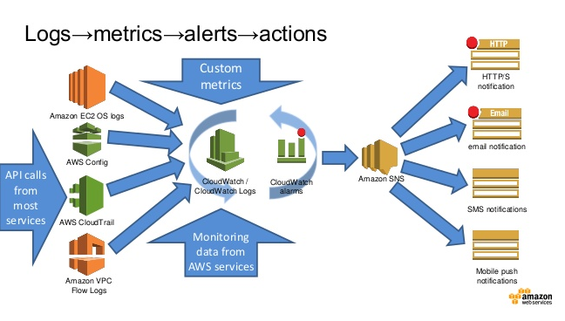
AWS Cloud Watch
Notes:
Amazon CloudWatch monitors your Amazon Web Services (AWS) resources and the applications you run on AWS in real-time.
Use CloudWatch to collect and track metrics, which are the variables you want to measure for your resources and applications.
CloudWatch alarms send notifications or automatically make changes to the resources you are monitoring based on rules that you define.
Cloud Watch monitors the CPU usage and disk reads and writes of your Amazon Elastic Compute Cloud (Amazon EC2) instances and then use this data to determine whether you should launch additional instances to handle increased load.
You can also use this data to stop under-used instances to save money.
you can monitor your own custom metrics. With CloudWatch, you gain system-wide visibility into resource utilization, application performance, and operational health
Cloud resources and the applications you run on AWS. You can use Amazon CloudWatch to collect and track metrics, collect and monitor log files, set alarms, and automatically react to changes in your AWS resources. Amazon CloudWatch can monitor AWS resources such as Amazon EC2 instances, Amazon DynamoDB tables, and Amazon RDS DB instances, as well as custom metrics generated by your applications and services, and any log files your applications generate. You can use Amazon CloudWatch to gain system-wide visibility into resource utilization, application performance, and operational health. You can use these insights to react and keep your application running smoothly.
Amazon CloudWatch provides a reliable, scalable, and flexible monitoring solution that you can start using within minutes. You no longer need to set up, manage, and scale your own monitoring systems and infrastructure.
Amazon CloudWatch enables you to monitor your AWS resources in near real-time, including Amazon EC2 instances, Amazon EBSvolumes, Elastic Load Balancers, and Amazon RDS DB instances. Metrics such as CPU utilization, latency, and request counts are provided automatically for these AWS resources. You can also supply your own logs or custom application and system metrics, such as memory usage, transaction volumes, or error rates, and Amazon CloudWatch will monitor these too.
With Amazon CloudWatch, you can access up-to-the-minute statistics, view graphs, and set alarms for your metric data to help you troubleshoot, spot trends, and take automated action based on the state of your cloud environment. Amazon CloudWatch functionality is accessible via API, command-line tools, the AWS SDK, and the AWS Management Console.
mazon CloudWatch automatically monitors Elastic Load Balancers for metrics such as request count and latency; Amazon EBS volumes for metrics such as read/write latency; Amazon RDS DB instances for metrics such as freeable memory and available storage space; Amazon SQS queues for metrics such as number of messages sent and received; and Amazon SNS topics for metrics such as number of messages published and delivered. No additional software needs to be installed to monitor other AWS resources.
Features & Benefits
Monitor Amazon EC2
View metrics for CPU utilization, data transfer, and disk usage activity from Amazon EC2 instances (Basic Monitoring) for no additional charge. For an additional charge, CloudWatch provides Detailed Monitoring for EC2 instances with higher resolution and metric aggregation. No additional software needs to be installed.
Learn more »
Monitor Other AWS Resources
Monitor metrics on Amazon DynamoDB tables, Amazon EBS volumes, Amazon RDS DB instances, Amazon Elastic MapReduce job flows, Elastic Load Balancers, Amazon SQS queues, Amazon SNS topics, and more for no additional charge. No additional software needs to be installed.
Learn more »
Monitor Custom Metrics
Submit Custom Metrics generated by your own applications via a simple API request and have them monitored by Amazon CloudWatch. You can send and store metrics that are important to your application’s operational performance to help you troubleshoot and spot trends.
Learn more »
Monitor and Store Logs
You can use CloudWatch Logs to monitor and troubleshoot your systems and applications using your existing system, application, and custom log files. You can send your existing system, application, and custom log files to CloudWatch Logs and monitor these logs in near real-time. This can help you better understand and operate your systems and applications, and you can store your logs using highly durable, low-cost storage for later access.
Learn more »
Set Alarms
Set alarms on any of your metrics to send you notifications or take other automated actions. For example, when a specific Amazon EC2 metric crosses your alarm threshold, you can use Auto Scaling to dynamically add or remove EC2 instances or send you a notification.
Learn more »
View Graphs and Statistics
Amazon Cloudwatch Dashboards enable you to create re-usable graphs of AWS resources and custom metrics so you can quickly monitor operational status and identify issues at a glance. Metric data is kept for a period of two weeks enabling you to view up to the minute data and also historical data. Amazon CloudWatch can load all the metrics in your account for search and graphing with the AWS Management Console. This includes logs, AWS resource metrics, and application metrics that you provide.
Learn more »
Monitor and React to Resource Changes
CloudWatch Events provides a stream of events describing changes to your AWS resources. You can easily build workflows that automatically take actions you define, such as invoking an AWS Lambda function, when an event of interest occurs.

Slide 23
AWS Cloud Front
Cloud-based content distributing network enables you to place the content at the edges of the network for rapid delivery.
Place the contents in S3 and run the application from anywhere and the content is moved to where the application is (to the edges).
Notes:
Amazon CloudFront content delivery network (CDN) is a web service for content delivery. Amazon CloudFront makes your website's dynamic, static, and streaming content available from a global network of edge locations. When a visitor requests a file from your website, he or she is invisibly redirected to a copy of the file at the nearest edge location, which results in faster download times than if the visitor had accessed the content from a data center farther away. Amazon CloudFront caches content at edge locations for a period of time that you specify.
Amazon CloudFront supports all files that can be served over HTTP. This includes dynamic web pages, such as HTML or PHP pages, any popular static files that are a part of your web application, such as website images, audio, video, media files or software downloads. For on-demand media files, you can also choose to stream your content using Real-Time Messaging Protocol (RTMP) delivery. Amazon CloudFront also supports delivery of live media over HTTP.
Amazon CloudFront has two pricing components: regional data transfer out (per GB) and requests (per 10,000). Note that it is often cheaper (as well as faster) to deliver popular content from Amazon S3 through Amazon CloudFront rather than directly from Amazon S3.

Slide 24
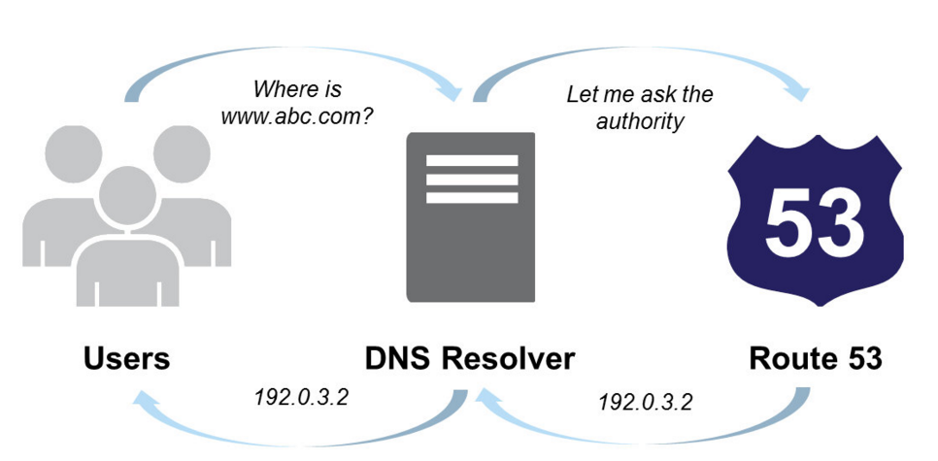
AWS Route 53
Notes:
Route 53 is a highly available and scalable cloud Domain Name System (DNS) web service. It is designed to give developers and businesses an extremely reliable and cost effective way to route end users to Internet applications by translating names like www.example.com into the numeric IP addresses like 192.0.2.1 that computers use to connect to each other.
Amazon Route 53 effectively connects user requests to infrastructure running in AWS – such as Amazon EC2 instances, Elastic Load Balancing load balancers, or Amazon S3 buckets – and can also be used to route users to infrastructure outside of AWS.

Slide 25
Multi-AZ Deployment
Availability Zones: are distinct locations within a Region that are engineered to be isolated from failures in other Availability Zones.
Run a DB Instance as a Multi-AZ deployment, the “primary” serves database writes and reads. Amazon RDS provisions and maintains a “standby” behind the scenes, which is an up-to-date replica of the primary. The standby is “promoted” in failover scenarios. After failover, the standby becomes the primary and accepts your database operations.

Slide 26
Scalability- Scale Up vs. Scale Out
Scale Up/Vertical Scaling
Select next available configuration (EC2, RDS)
Relatively simple but limited scalability
Scale Out/Horizontal Scaling
Add additional resources
Complicated but high scalability
RDS Read replicas

Slide 27
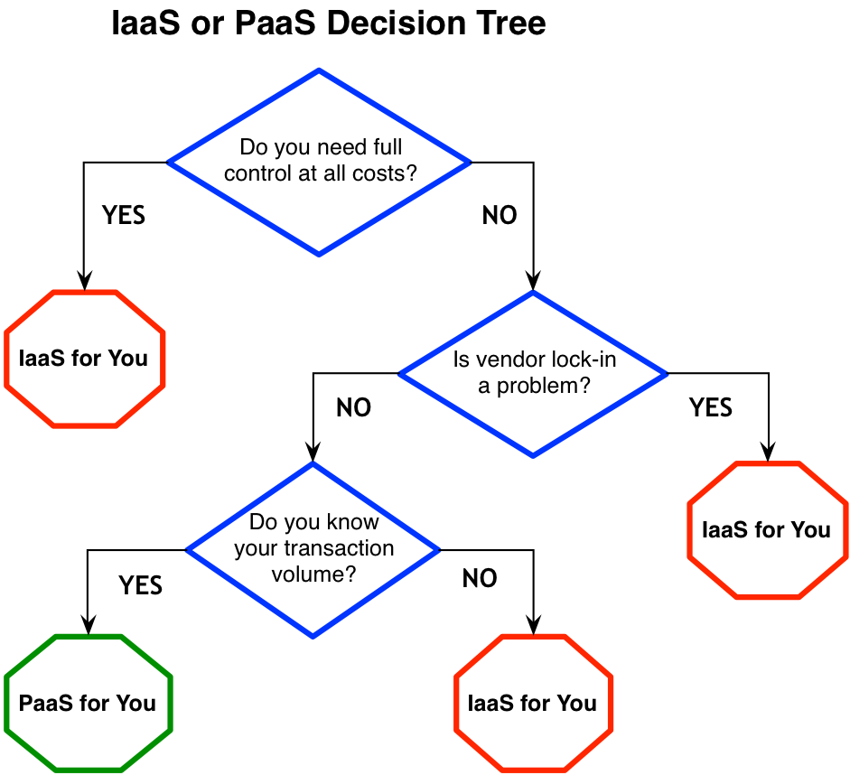

Slide 28
heard of 3 models of Cloud Computing?
Yes, Yes, IaaS, PaaS and SaaS

Slide 29
Introduction to PaaS
Platform as a Service, referred to as PaaS, is a category of cloud computing that provides a platform and environment to allow developers to build applications and services over the internet.
Platform as a Service allows users to create software applications using tools supplied by the provider.
PaaS services are hosted in the cloud and accessed by users simply via their web browser.
PaaS services can consist of preconfigured features that customers can subscribe to; they can choose to include the features that meet their requirements while discarding those that do not.

Slide 30
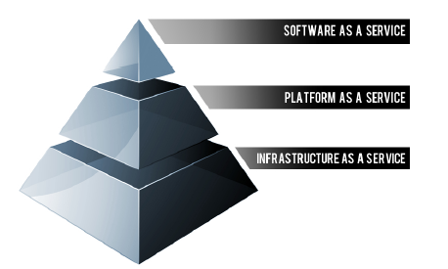
Building blocks of PaaS
PaaS providers can assist developers from the conception of their original ideas to the creation of applications, and through to testing and deployment.
Below are some of the features that can be included with a PaaS offering:
Operating system
Server-side scripting environment
Database management system
Server Software
Support
Storage
Network access
Tools for design and development
Hosting

Slide 31
Characteristics of PAAS
Services to develop, test, deploy, host and maintain applications in the same integrated development environment. All the varying services needed to fulfill the application development process
Web based user interface creation tools help to create, modify, test and deploy different UI scenarios
Multi-tenant architecture where multiple concurrent users utilize the same development application
Built in scalability of deployed software including load balancing and failover
Integration with web services and databases via common standards
Support for development team collaboration – some PaaS solutions include project planning and communication tools
Tools to handle billing and subscription management

Slide 32
Characteristics of PAAS
PaaS, which is similar in many ways to Infrastructure as a Service, is differentiated from IaaS by the addition of value added services and comes in two distinct flavours;
A collaborative platform for software development, focused on workflow management regardless of the data source being used for the application. An example of this approach would be Heroku, a PaaS that utilizes the Ruby on Rails development language.
A platform that allows for the creation of software utilizing proprietary data from an application. This sort of PaaS can be seen as a method to create applications with a common data form or type. An example of this sort of platform would be the Force.com. PaaS from Salesforce.com which is used almost exclusively to develop applications that work with the Salesforce.com CRM

Slide 33
Advantages and Risks
Advantages
Users don’t have to invest in physical infrastructure
PaaS allows developers to frequently change or upgrade operating system features. It also helps development teams collaborate on projects.
Makes development possible for ‘non-experts’
Teams in various locations can work together
Security is provided, including data security and backup and recovery.
Adaptability; Features can be changed if circumstances dictate that they should.
Flexibility; customers can have control over the tools that are installed within their platforms and can create a platform that suits their specific requirements. They can ‘pick and choose’ the features they feel are necessary.

Slide 34
Advantages and Risks
Risks
Since users rely on a provider's infrastructure and software, vendor lock-in can be an issue in PaaS environments.
Other risks associated with PaaS are provider downtime or a provider changing its development roadmap.
If a provider stops supporting a certain programming language, users may be forced to change their programming language, or the provider itself. Both are difficult and disruptive steps.

Slide 35
Amazon Relational Database Service (RDS)
Amazon Relational Database Service a web service that provides the capabilities of MySQL, Oracle, or Microsoft SQL Server relational database as a managed, cloud-based service
On-demand provisioning
No operating system for you to access
Platforms:
MySQL
Oracle
SQL Server
PostgreSQL
“Mostly” pre-configured
Basic monitoring / metrics provided
Automated backups
Automated recovery
User initiated “snapshots”
Automated replication
Software upgrades provided
Notes:
Amazon RDS makes it easy to set up, operate, and scale Oracle Database deployments in the cloud. With Amazon RDS, you can deploy multiple editions of Oracle Database in minutes with cost-efficient and re-sizable hardware capacity. Amazon RDS frees you up to focus on application development by managing time-consuming database administration tasks including provisioning, backups, software patching, monitoring, and hardware scaling.
Amazon RDS delivers high performance through a combination of configurable instances running on Amazon’s proven, world-class infrastructure with fully-automated maintenance and backup operations. Available database configurations range from a small instance (64-bit platform with 1.7 GB of RAM and 1 Amazon EC2 compute unit (ECU)) up to a quadruple extra-large instance (64-bit platform with 68 GB of RAM and 26 ECUs).
Available database configurations range from a small instance (64-bit platform with 1.7 GB of RAM and 1 Amazon EC2 compute unit (ECU)) up to a quadruple extra-large instance (64-bit platform with 68 GB of RAM and 26 ECUs).
Amazon RDS Provisioned IOPS provides a high-performance storage option designed to deliver fast, predictable, and consistent performance for I/O intensive transactional database workloads. When creating a new DB instance using the Amazon RDS Provisioned IOPS storage, you can specify the IOPS your instance needs from 1,000 IOPS to 30,000 IOPS and Amazon RDS provisions that IOPS rate for the lifetime of the instance.

Slide 36
RDS Features and Functionality
Pre-configured Parameters
Monitoring and Metrics
Automatic Software Patching
Automated Backups
DB Snapshots
Push-Button Scaling
Automatic Host Replacement
Replication: two features
Multi-AZ Deployment, Read Replica
Notes:
Working with Amazon RDS
Amazon RDS allows you to use the AWS Management Console or a simple set of web services APIs to create, delete and modify relational database instances (DB Instances). You can also control access and security for your instance(s) and manage your database backups and snapshots. For a full list of the available Amazon RDS APIs, please see the Amazon RDS API Guide. Some of the most commonly used APIs and their functionality are listed below:
CreateDBInstance — Provision a new DB Instance, specifying the DB Engine (Oracle Database edition), license model, DB Instance class, storage capacity, DB Engine version (optional), character set (optional, default is AL32UTF8), the backup retention policy you wish to use, and whether you want to run the DB Instance as a Multi-AZ deployment. This one API call is all that’s needed to give you access to a running Oracle Database, with the software pre-installed and the available resource capacity you request.
ModifyDBInstance — Modify settings for a running DB Instance. This lets you use a single API call to scale the resources available to your DB Instance in response to the load on your database, or change how it is automatically backed up and maintained on your behalf. You can also use this API to gain optional control over how DB Engine versions are upgraded.
DeleteDBInstance — Delete a running DB Instance. With Amazon RDS, you can terminate your DB Instance at any time and pay only for the resources you used.
CreateDBSnapshot — Generate a snapshot of your DB Instance. You can restore your DB Instance to these user-created snapshots at any point, even to reinstate a previously deleted DB Instance.
RestoreDBInstanceToPointInTIme — Create a new DB Instance from a point-in-time backup. You can restore to any point within the retention period you specified, usually up to the last five minutes of your database’s usage.
https://aws.amazon.com/rds/oracle/details
Amazon RDS offers a tiered pricing structure, based on the size of the database instance, the deployment type (Single-AZ/Multi-AZ), and the AWS region. Pricing for Amazon RDS is based on several factors: the DB instance hours (per hour), the amount of provisioned database storage (per GB-month and per million I/O requests), additional backup storage (per GB-month), and data transfer in / out (per GB per month). Pricing information can be found at Amazon Relational Database Service Pricing.

Slide 37
Oracle Deployment options
RDS
Quick provisioning
“Easy” management
Simple environment setup
Simplified replication strategy
No OS-level control
Limited granular fine tuning
Limited platform / versions
EC2+Database
You manage it yourself
OS & storage overhead
Software / version management
Configuration
Usually more costly
More control over config / performance
Allows more complex setups

Slide 38
RDS Limitation
Failovers are NOT instant.
Can take up to 6 minutes. Maybe more, depending on database size
Only limited platforms / versions are supported.
Upgrades / patching requires downtime.
You set an allowable maintenance window. Amazon will upgrade sometime during that window.
Can suffer from “noisy neighbor” syndrome.
Performance issues are sometimes hard to pinpoint
Master-Master replication is NOT supported

